Slide 1
Building a prescribed fire database for the western United States
Kori Blankenship & Teresa Chapman

Slide 2
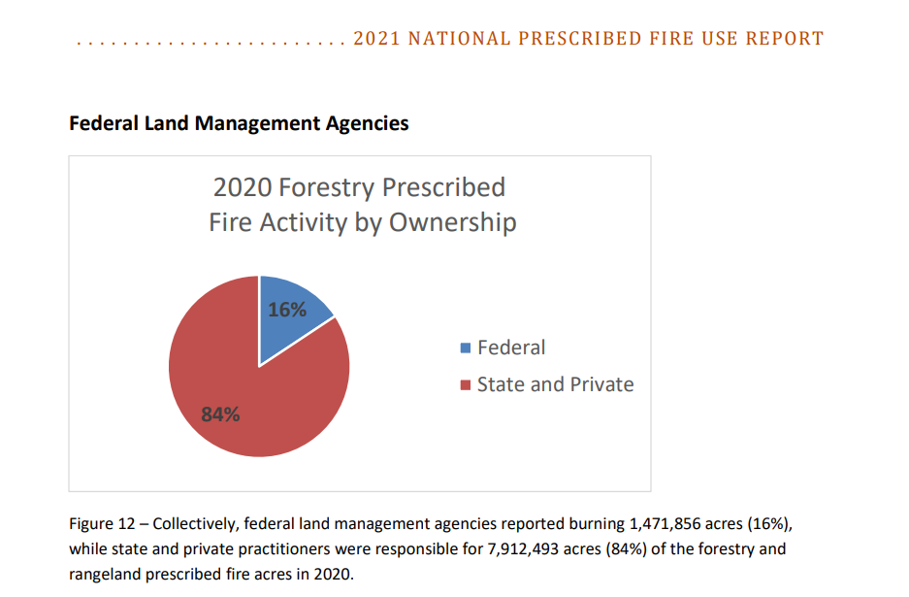
Intro
Problem:
Interested in fuel tx effectiveness
No reporting system for all burns
Difficult to detect rx fire remotely, private burns generally not collect in public repository
Notes:
While many prescribed burns are tracked, they are reported in different systems, with different reporting requirements, and sometimes difficult to find and poorly documented.
2021-National-Rx-Fire-Use-Report_FINAL.pdf (prescribedfire.net)
“This means that 84% of prescribed fire occurred on state and private lands in 2020”

Slide 3
Data
methods: # of records by state total
 | Burn Type¹ | Complete² | Polygon³ | Years of Collection
 |  |  |  | pre-2010 | 2010 | 2011 | 2012 | 2013 | 2014 | 2015 | 2016 | 2017 | 2018 | 2019 | 2020 | 2021 | 2022
AZ |  | X
CA | X | X | X
CO | X | X | X
ID | X
MT | X | X
ND
NM | X | X
NV | X | X
OR | X | X
SD
UT | X | X
WA | X |  | X
WY | X | X
¹Burn type indicates whether the permit distinguishes broadcast, pile, and other types of burning.
²Complete indicates state where burn completion is tracked. If it is not tracked, we only know what was permitted.
³Polygon indicates states with additional state-level polygon data about prescribed burns.
Notes:
State permit data are, to our knowledge, an untapped resource for tracking prescribed burns. These data will be especially useful for tracking burning on private lands, which are largely left out of other data collection efforts.
ND IS WRONG HERE
Make a horizontal bar plot w/ # of records and give the n as shown in screen cap above
Map: burn type reported, ag burns, Indian lands burns, permitted, complete, request

Slide 4
Methods – data compilation
Hella processing: permit, request, complete
Unique burns: state, year, lat/lon, burn type, tracking number, burn name
Planned acres: permitted acres, max requested acres, or completed acres

Slide 5
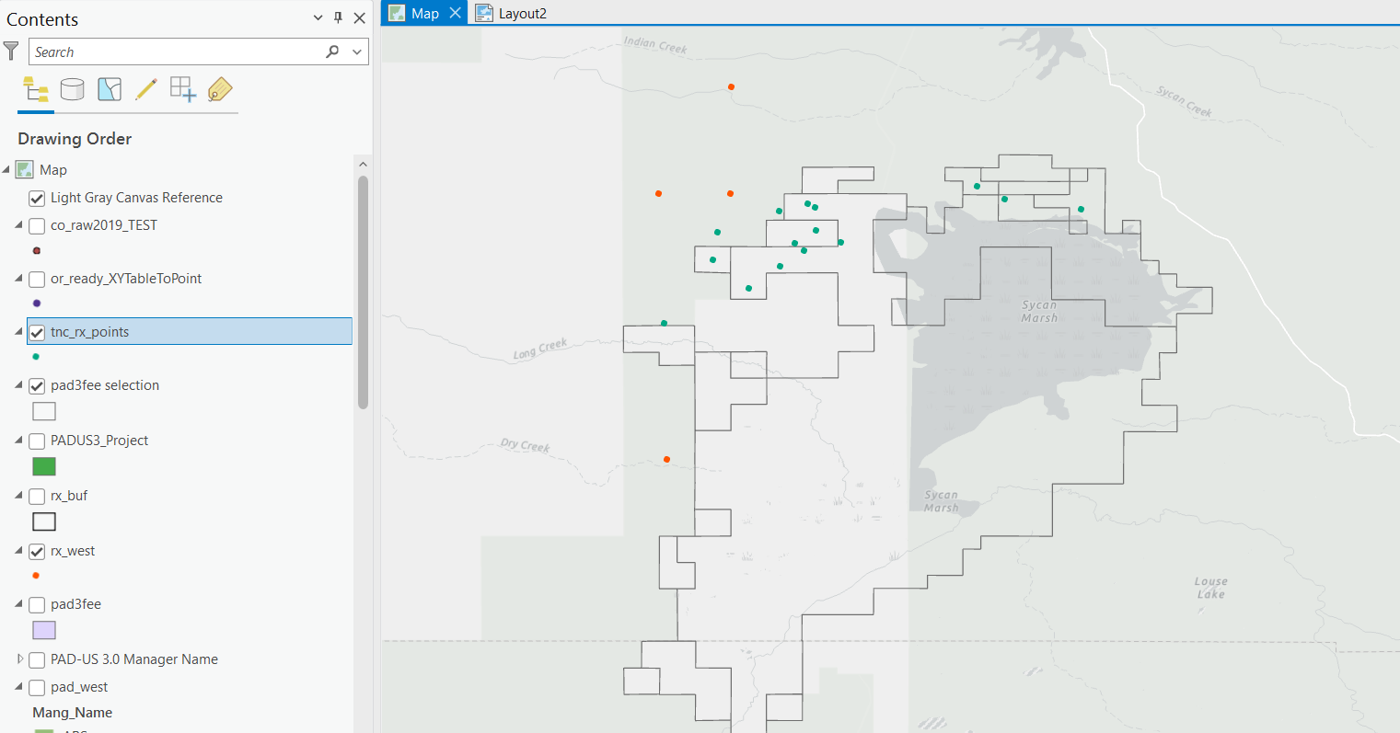
Methods - validation
Data are incomplete and not completable
Data are not validated and Completion? Validation?

Slide 6
Results
X unique burns planned or completed, 2017-2022
Amazing map here

Slide 7
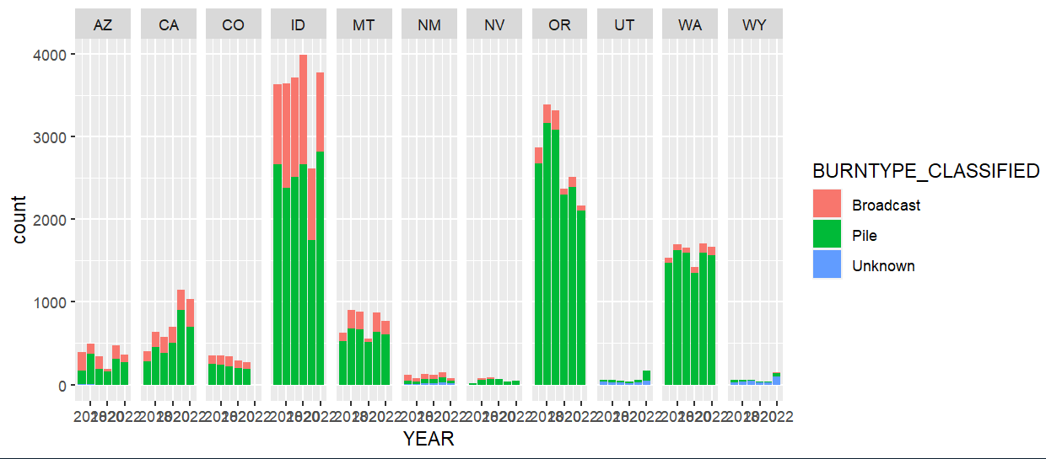
Results: planned ignitions by type
Estimated number of planned burns per year 2017-2022
Notes:
Add all west

Slide 8
Results: planned v completed
planned vs completed by state for consistent years; make the last one all west

Slide 9
Results: broadcast by ownership
stacked bar fed, state, pvt by state broadcast acres only; whole west

Slide 10
Results: broadcast fire size
fire size box and whiskers; average completed size by state

Slide 11
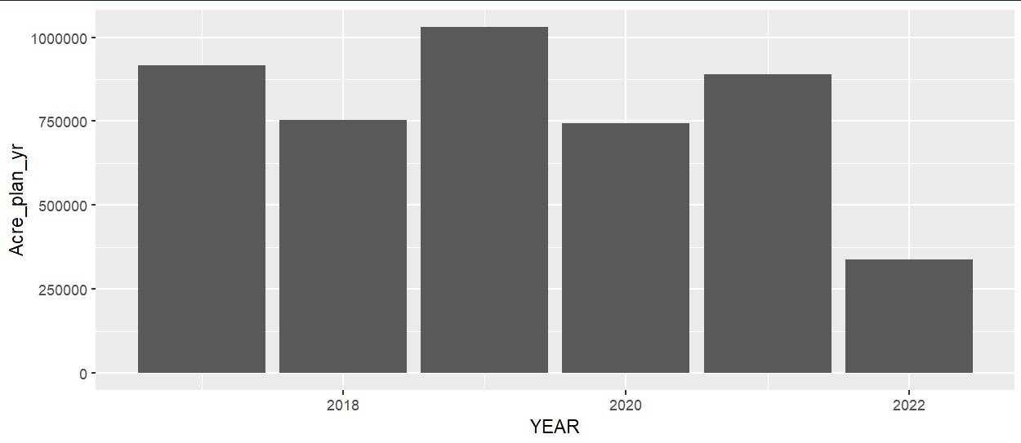
Results
Estimated acres planned X in states per year 2017-2022

Slide 12
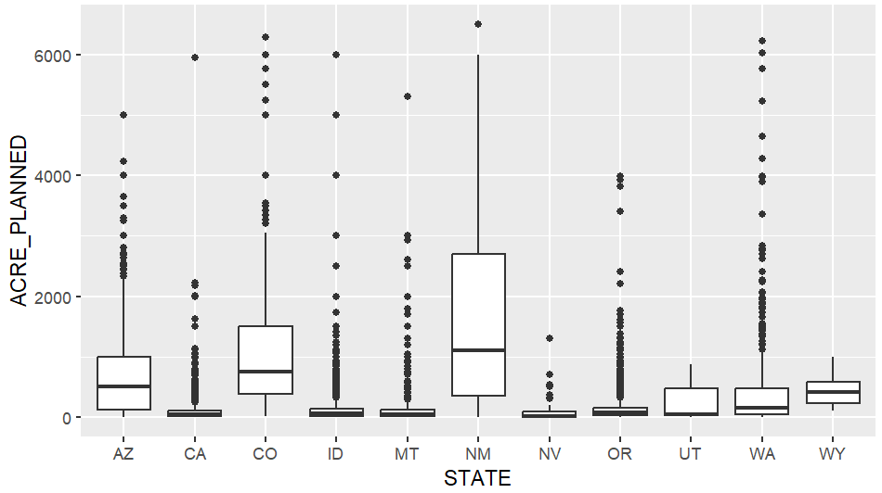
Results
Fire size (acres) for planned burns 2017-2022

Slide 13
Limitations
Results are first approximation

Slide 14
Next steps
Error checking
Validation
Overlay with other sources

Slide 15
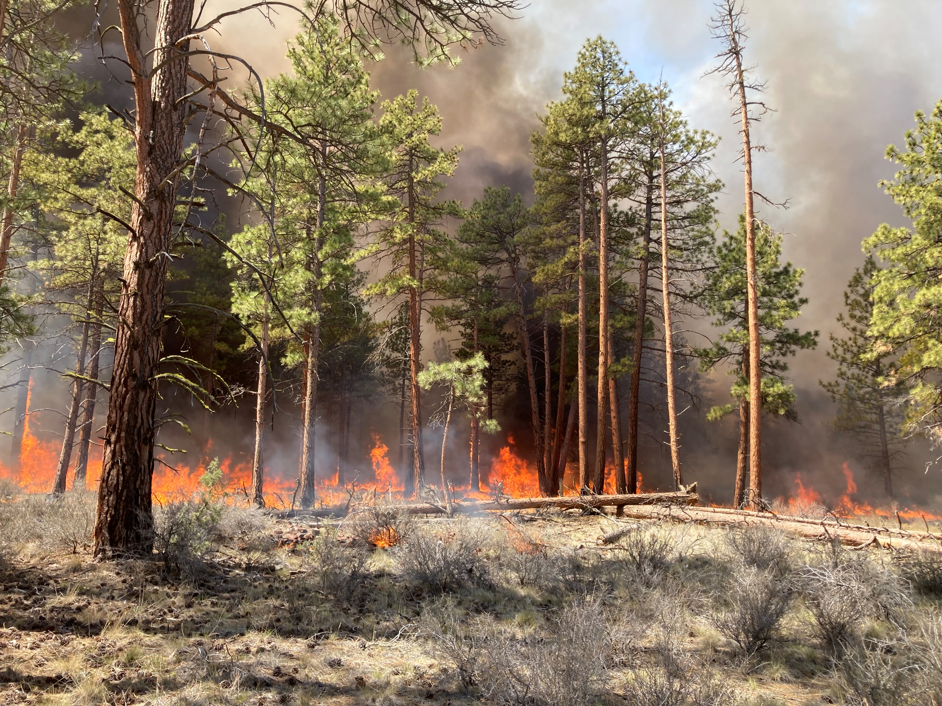
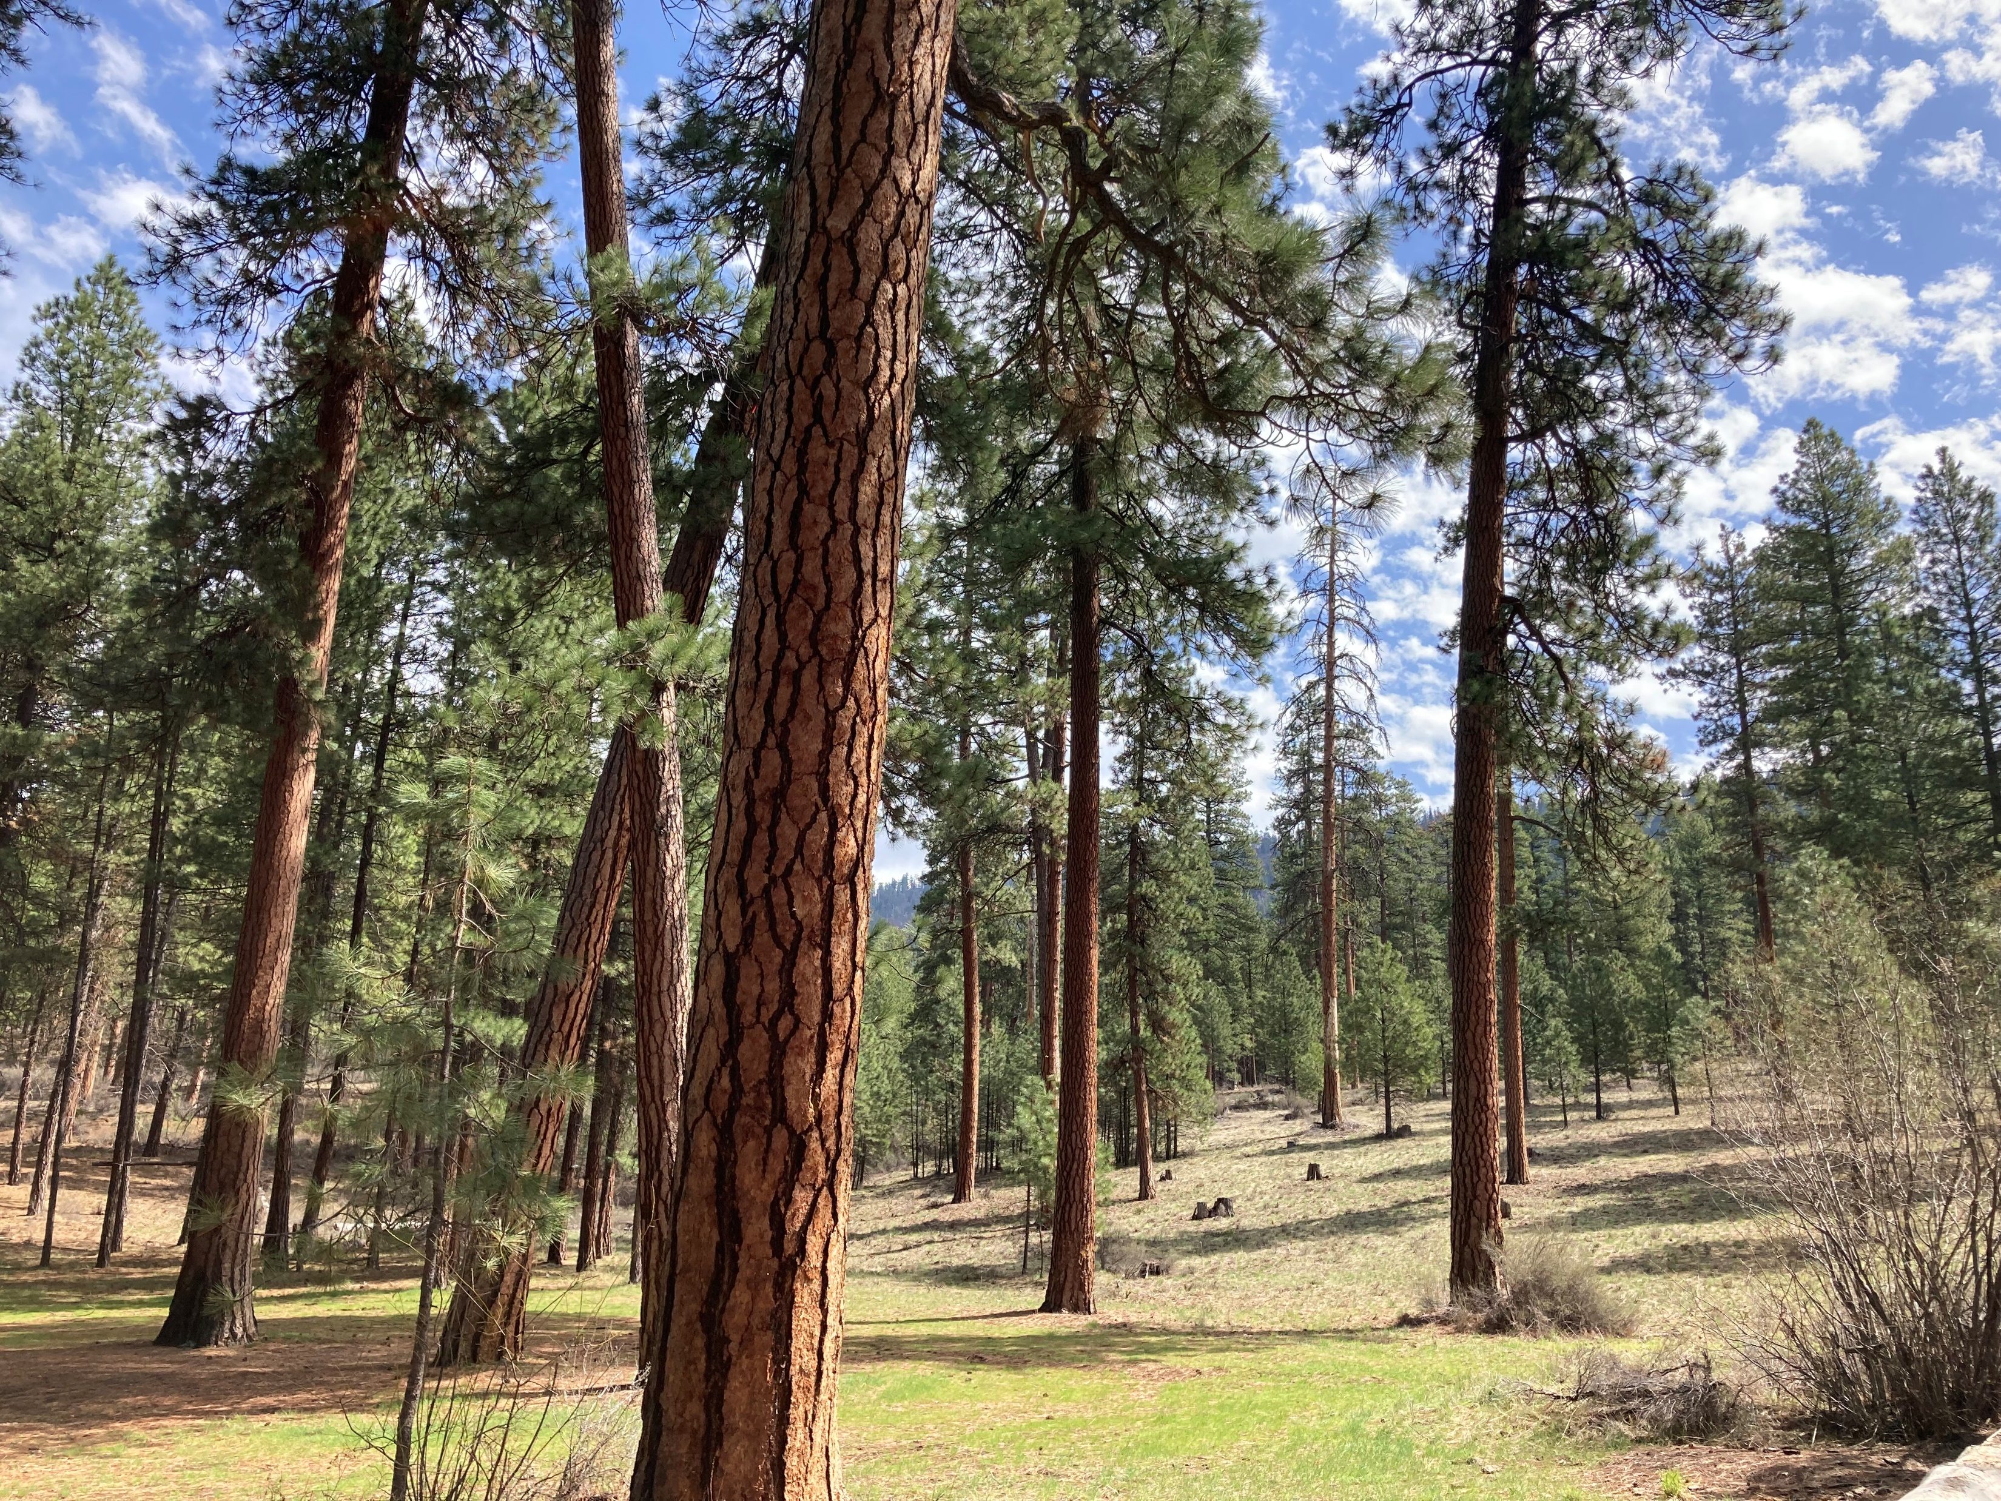
Conclusions

Slide 16
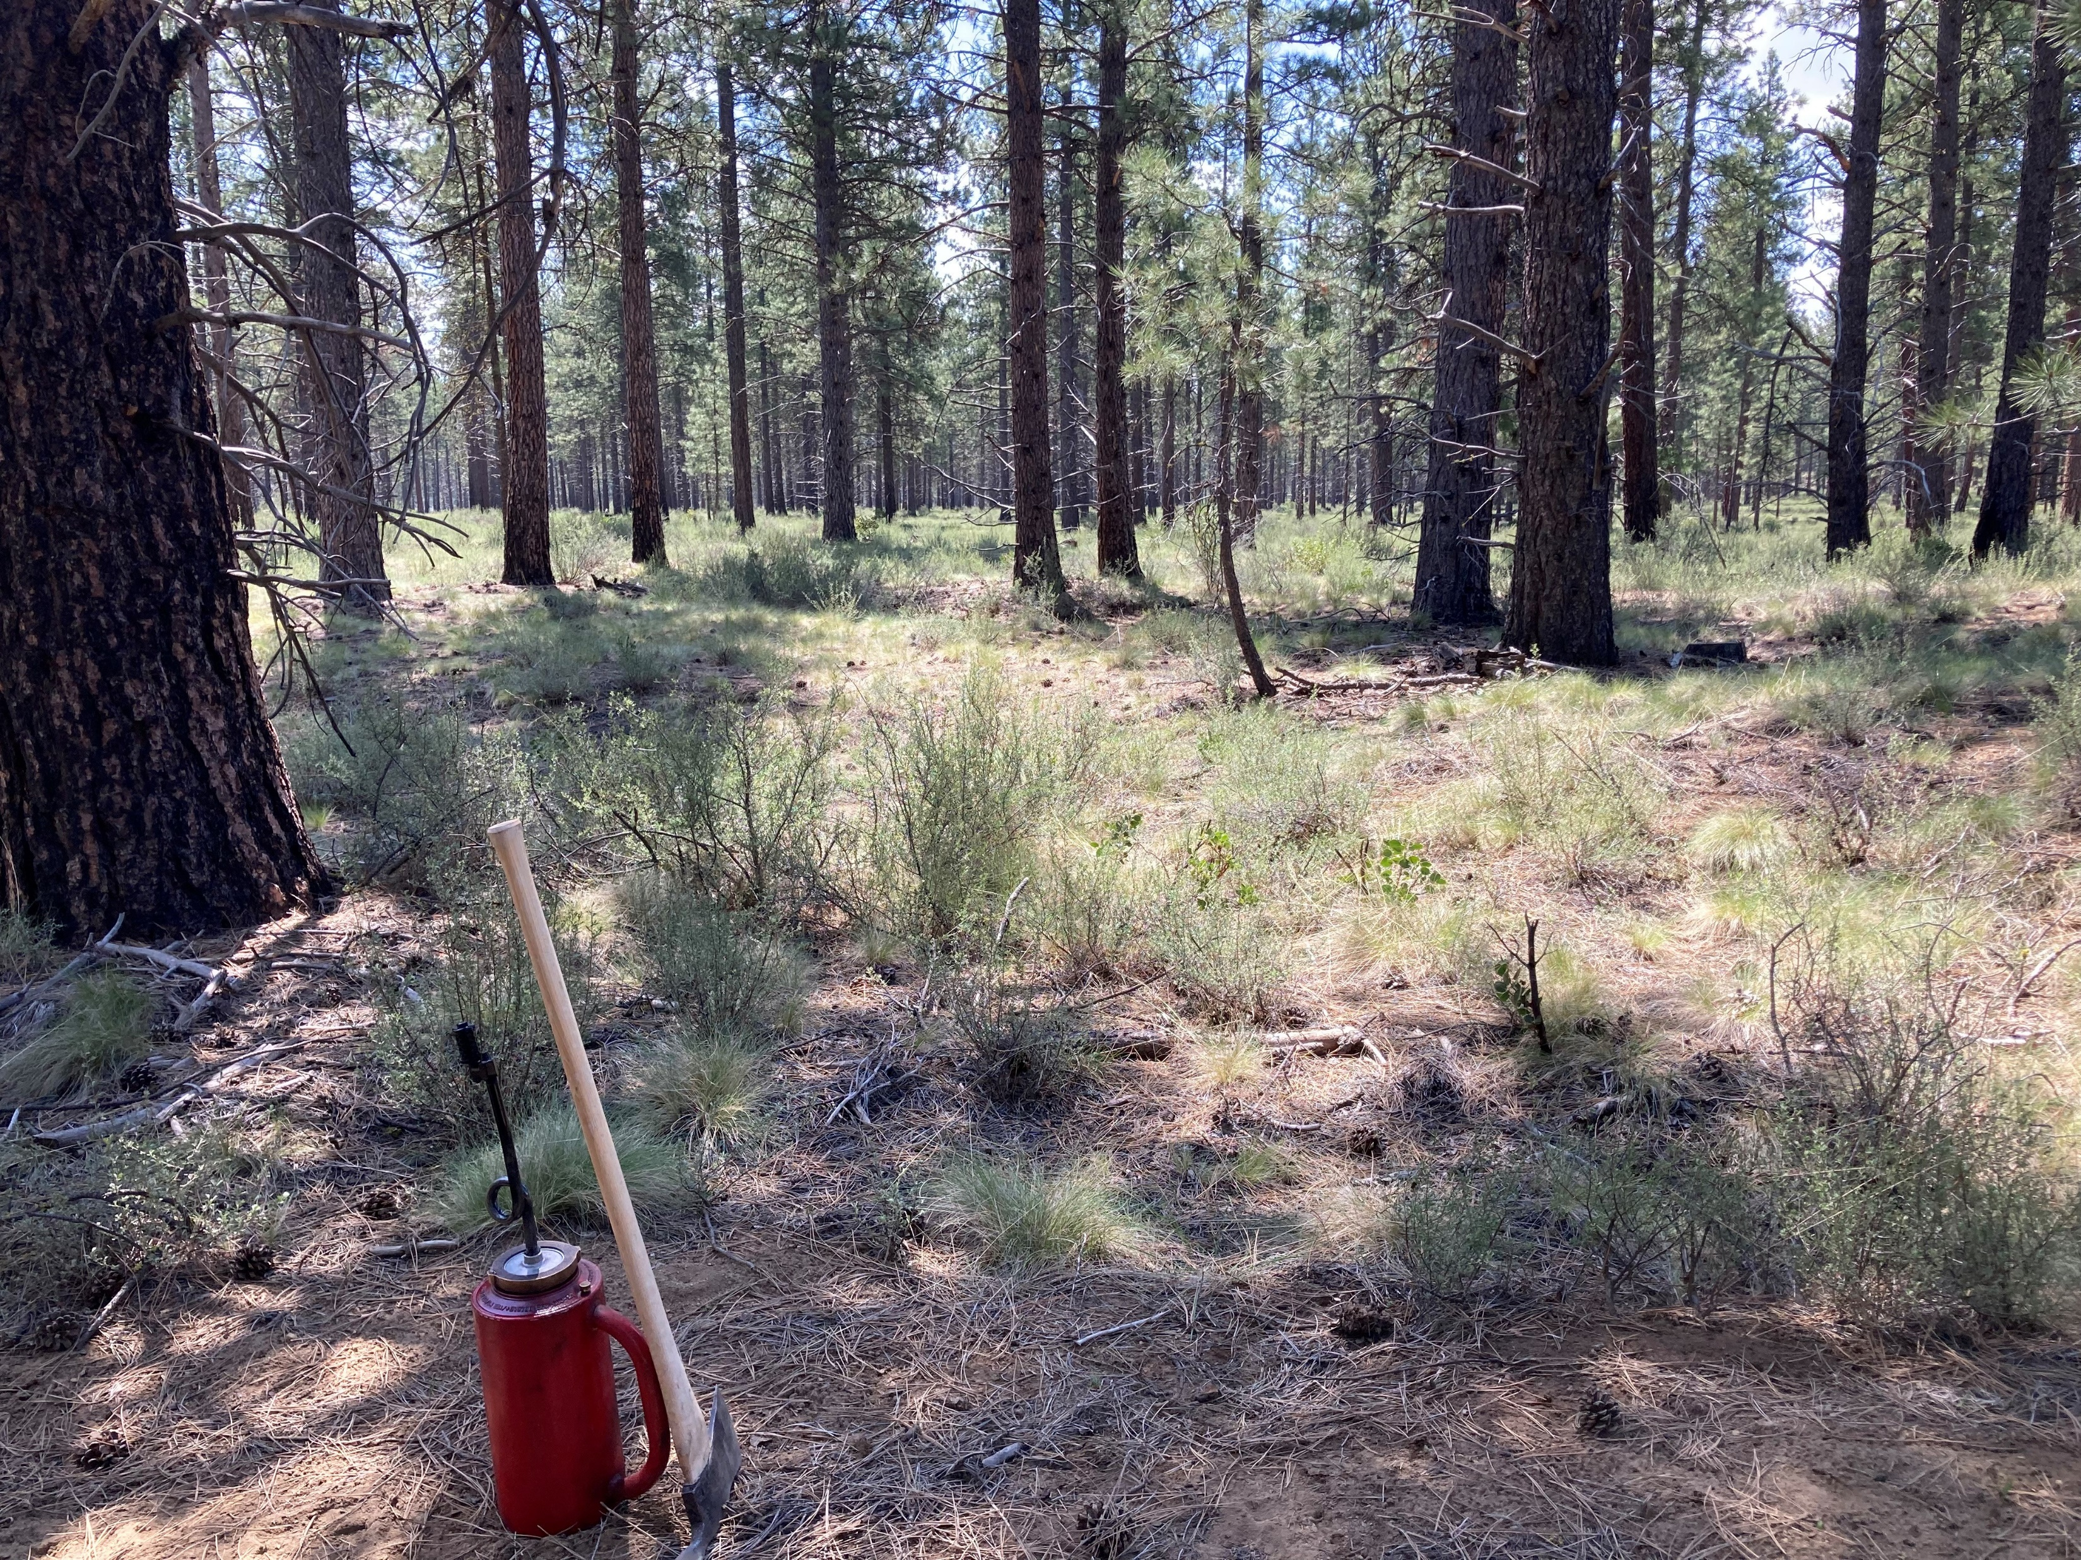
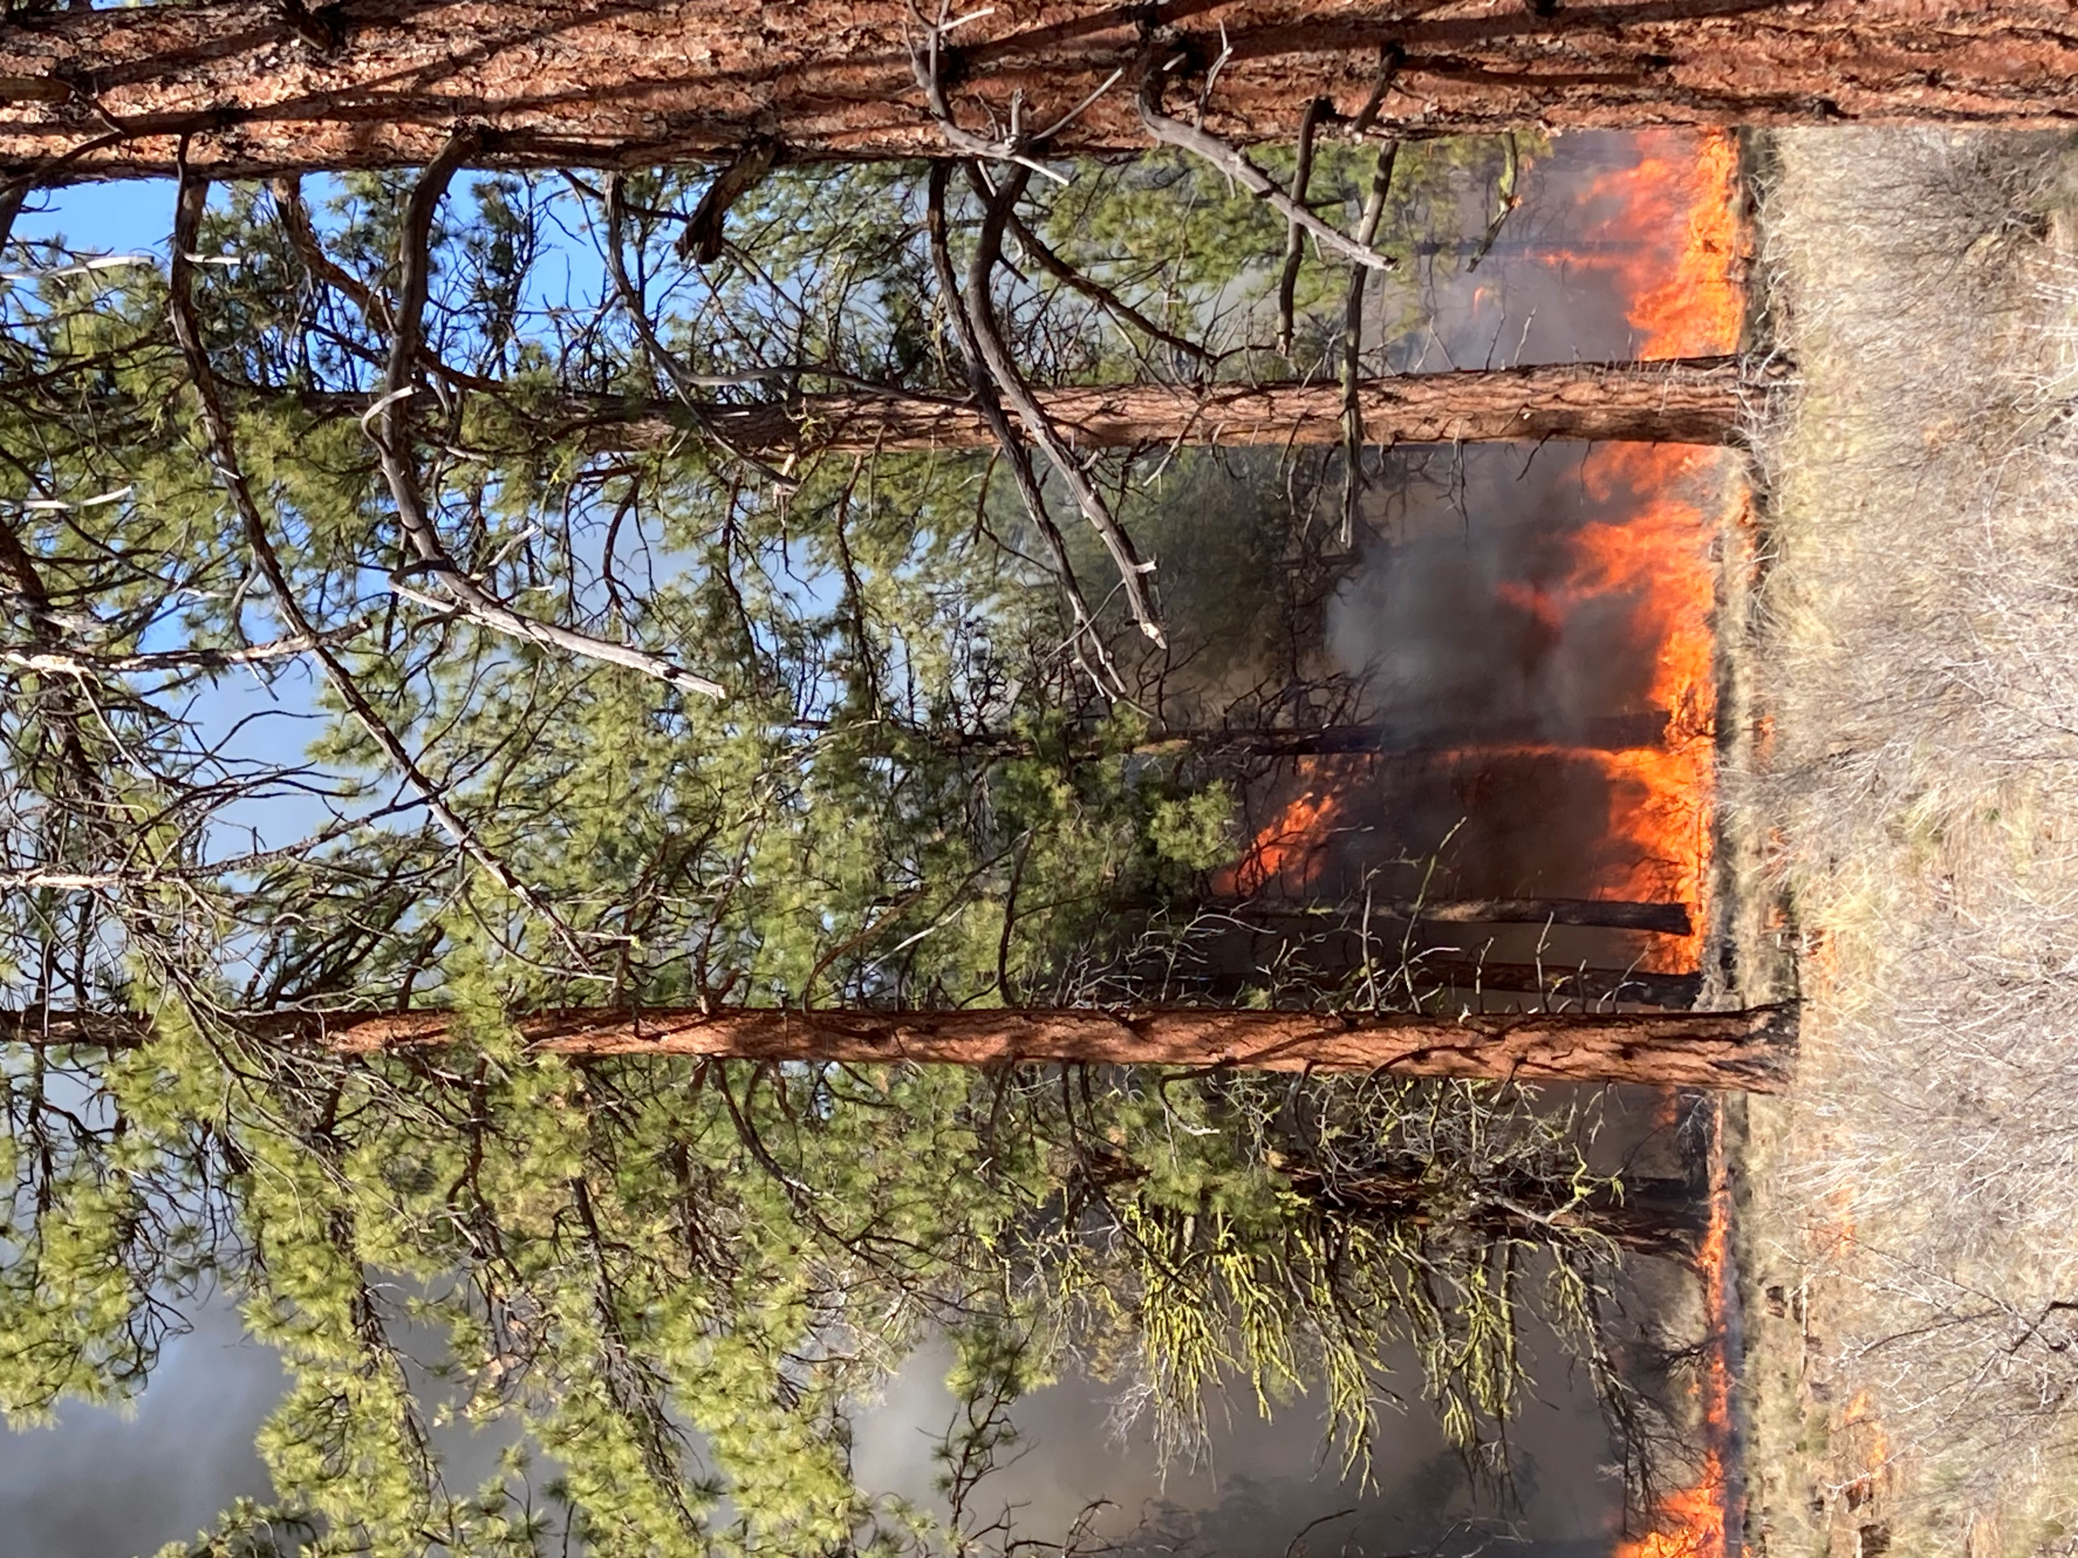
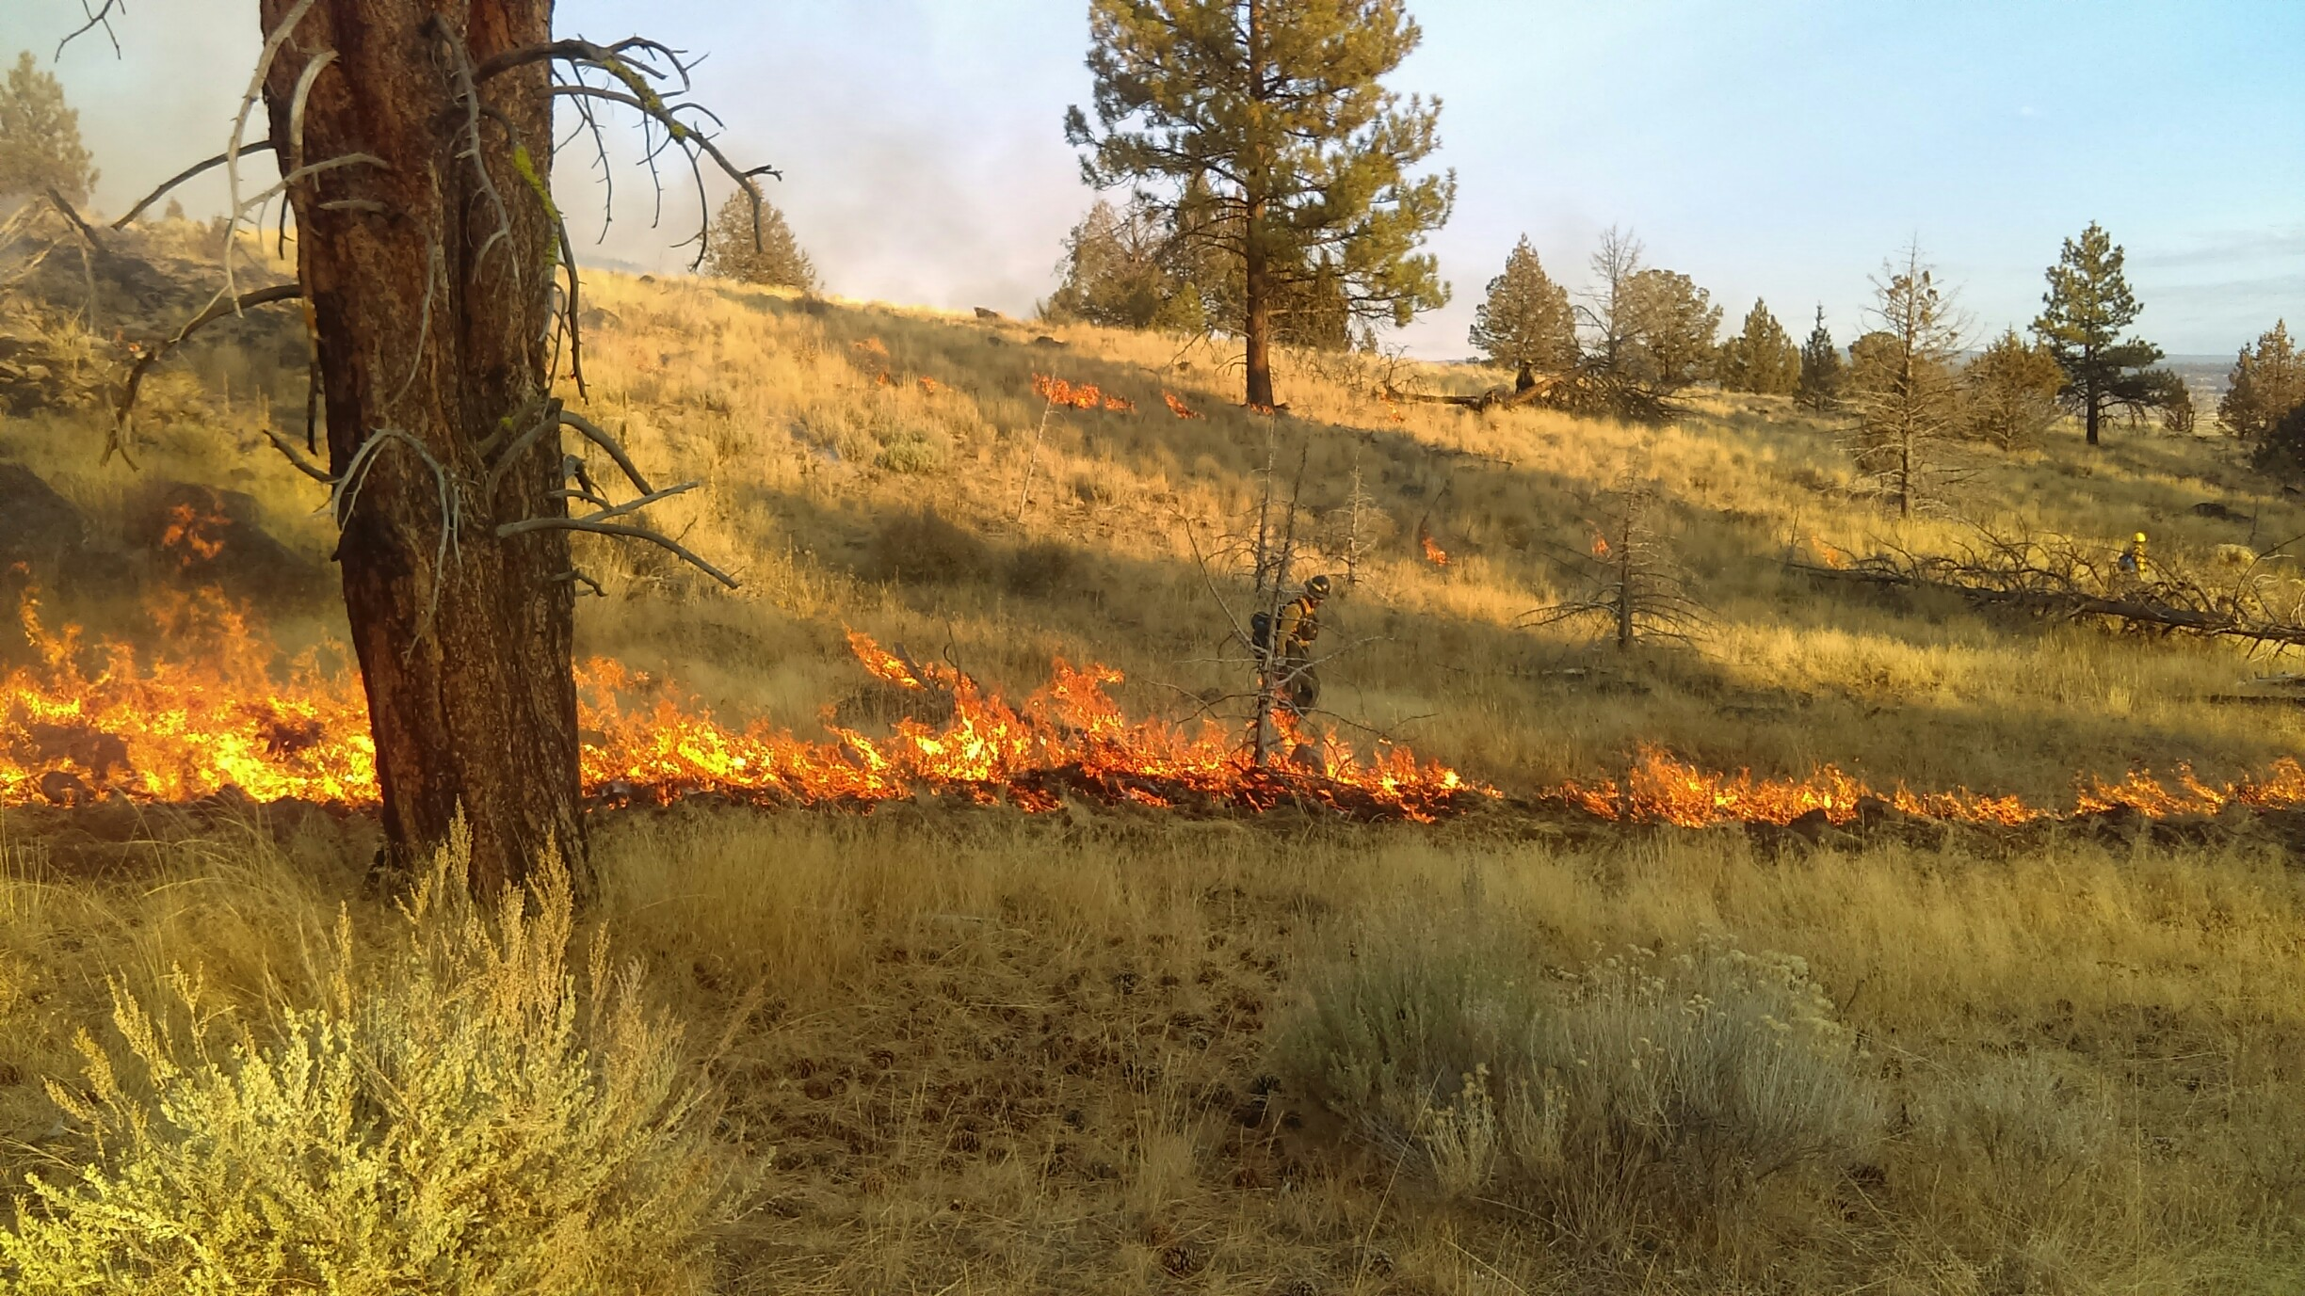
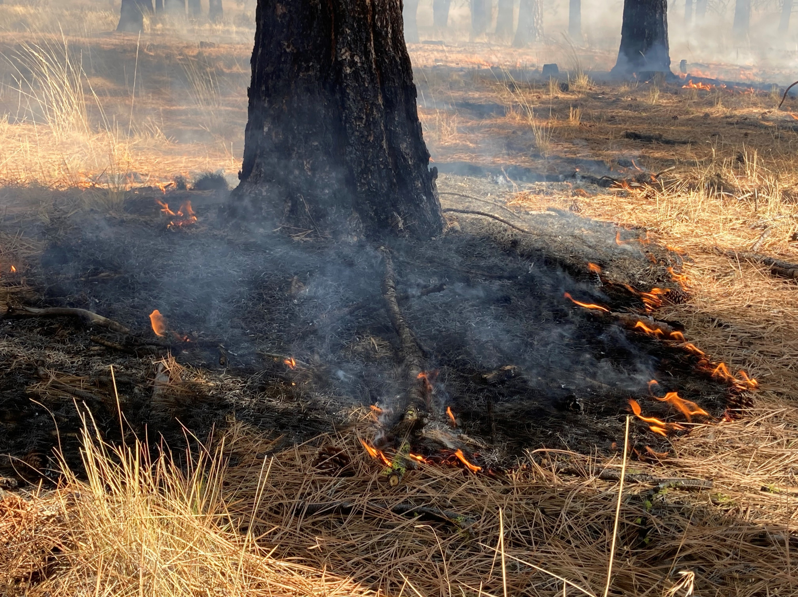

Slide 17
